Slide 1

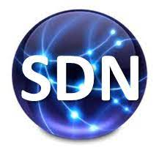
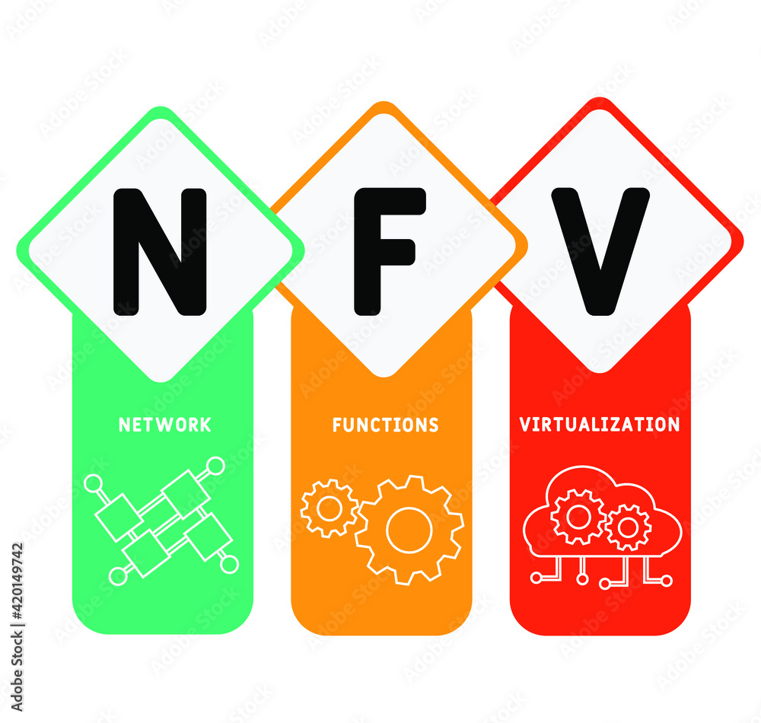

PDS
Computer Vision
Cloud Computing
Cloud provider
Architecture
https://github.com/siagianp
https://www.youtube.com/@AmelOline/videos
https://github.com/amelcharolinesgn2/IoT_simulator-mqtt-NodeRed
https://github.com/amelcharolinesgn2/Cloud-Infrastructures
https://github.com/amelcharolinesgn2/ClouD-Infrastructure-SISKA-2025
Notes:
https://docs.openstack.org/liberty/install-guide-rdo/overview.html

Slide 2
Cloud Computing:
Cloud computing is the delivery of computing services—including servers, storage, databases, networking, software, analytics, and intelligence—over the Internet (“the cloud”) to offer faster innovation, flexible resources, and economies of scale. You typically pay only for cloud services you use, helping lower your operating costs, run your infrastructure more efficiently and scale as your business needs change.

Slide 3
Benefits of cloud computing:
Cost
Cloud computing eliminates the capital expense of buying hardware and software and setting up and running on-site datacenters—the racks of servers, the round-the-clock electricity for power and cooling, the IT experts for managing the infrastructure. It adds up fast.
Speed
Most cloud computing services are provided self service and on demand, so even vast amounts of computing resources can be provisioned in minutes, typically with just a few mouse clicks, giving businesses a lot of flexibility and taking the pressure off capacity planning.
Global scale
The benefits of cloud computing services include the ability to scale elastically. In cloud speak, that means delivering the right amount of IT resources—for example, more or less computing power, storage, bandwidth—right when it is needed and from the right geographic location.

Slide 4
Productivity:
On-site datacenters typically require a lot of “racking and stacking”—hardware setup, software patching, and other time-consuming IT management chores. Cloud computing removes the need for many of these tasks, so IT teams can spend time on achieving more important business goals.
Performance
The biggest cloud computing services run on a worldwide network of secure datacenters, which are regularly upgraded to the latest generation of fast and efficient computing hardware. This offers several benefits over a single corporate datacenter, including reduced network latency for applications and greater economies of scale.

Slide 5
Reliability
Cloud computing makes data backup, disaster recovery and business continuity easier and less expensive because data can be mirrored at multiple redundant sites on the cloud provider’s network.
Security
Many cloud providers offer a broad set of policies, technologies and controls that strengthen your security posture overall, helping protect your data, apps and infrastructure from potential threats.

Slide 6
 | Traditional Computing | Cloud Computing
1 | Data storage on local Internal / hard drive | Data storage in the cloud or external server
2 | Extra storage – pay for hardware, no unlimited storage | Unlimited storage – no extra hardware required
3 | For hardware configuration, you may hire expert | No need to do hardware configuration – dynamic resources
4 | Pay for power, electricity, AC cooling etc. | No expense on power, electricity, AC cooling etc.
5 | If you need to add new server it will take few days and more charges apply. | Pay for use, dynamic resources allocation.
6 | Fixed charges – installation, hardware used. | If resources are use less, then pay less
7 | Lack of isolation – high risk of security and poor performance. | No need to worry about security / loss of data.
8 | Backup and recovery take risky. | Backup and recovery very easy.
9 | Extra pay for software installation & upgrade. | Automatic software upgrade available
10 | Pay for extra hardware & other resources | On demand resources

Slide 7
Cloud Computing architecture:
Cloud Computing architecture comprises of many cloud components, which are loosely coupled. We can broadly divide the cloud architecture into two parts:
Front End
Back End
Each of the ends is connected through a network, usually Internet.
Front End
The front end refers to the client part of cloud computing system. It consists of interfaces and applications that are required to access the cloud computing platforms, Example - Web Browser.
Back End
The back End refers to the cloud itself. It consists of all the resources required to provide cloud computing services. It comprises of huge data storage, virtual machines, security mechanism, services, deployment models, servers, etc.

Slide 8
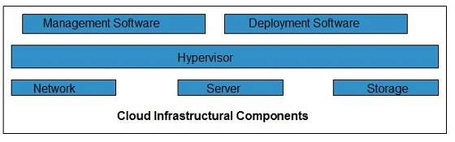
Cloud infrastructure consists of servers, storage devices, network, cloud management software, deployment software, and platform virtualization.

Slide 9
Hypervisor:
Hypervisor is a firmware or low-level program that acts as a Virtual Machine Manager. It allows to share the single physical instance of cloud resources between several tenants.
Management Software:
It helps to maintain and configure the infrastructure.
Deployment Software:
It helps to deploy and integrate the application on the cloud.
Network:
It is the key component of cloud infrastructure. It allows to connect cloud services over the Internet. It is also possible to deliver network as a utility over the Internet, which means, the customer can customize the network route and protocol.

Slide 10
Server:
The server helps to compute the resource sharing and offers other services such as resource allocation and de-allocation, monitoring the resources, providing security etc.
Storage:
Cloud keeps multiple replicas of storage. If one of the storage resources fails, then it can be extracted from another one, which makes cloud computing more reliable.

Slide 11
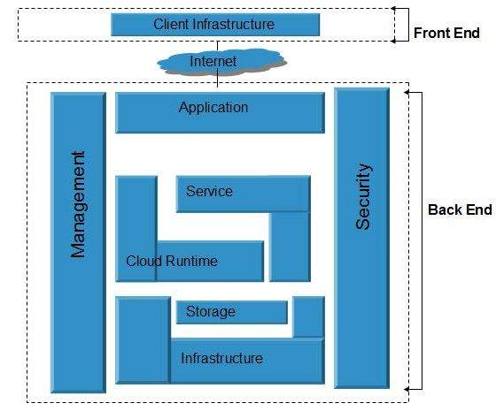

Slide 12
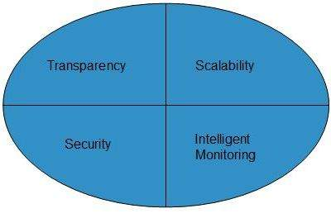
Infrastructural Constraints:
Fundamental constraints that cloud infrastructure should implement are shown in the following diagram:

Slide 13
Cluster Computing:
Cluster computing or High-Performance computing frameworks is a form of computing in which bunch of computers (often called nodes) that are connected through a LAN (local area network) so that, they behave like a single machine. A computer cluster help to solve complex operations more efficiently with much faster processing speed, better data integrity than a single computer and they only used for mission-critical applications.
Some of the critical Applications of Cluster Computers are Google Search Engine, Petroleum Reservoir Simulation, Earthquake Simulation, Weather Forecasting.

Slide 14
Types of Cluster computing:
1. Load-balancing clusters: As the name implies, This system is used to distribute workload across multiple computers. That system distributes the processing load as possible across a cluster of computers. 2. High availability (HA) clusters: A high availability clusters (HA cluster) are the bunch of computers that can reliably utilise for redundant operations in the event of nodes failure in Cluster computing. 3. High performance (HP) clusters: This computer networking methodology use supercomputers and Cluster computing to solve advanced computation problems.

Slide 15
Advantages of using Cluster computing
Cost efficiency: In a Cluster computing Cost efficiency is the ratio of cost to output, that is the connecting group of the computer as computer cluster much cheaper as compared to mainframe computers.
Processing speed: The Processing speed of computer cluster is the same as a mainframe computer.
Expandability: The best benefit of Cluster Computing is that it can be expanded easily by adding the additional desktop workstation to the system.
High availability of resources: If any node fails in a computer cluster, another node within the cluster continue to provide uninterrupted processing. When a mainframe system fails, the entire system fails.

Slide 16
Grid Computing:
Grid computing is the practice of leveraging multiple computers, often geographically distributed but connected by networks, to work together to accomplish joint tasks. It is typically run on a “data grid” a set of computers that directly interact with each other to coordinate jobs.
How Does Grid Computing Work?
Grid computing works by running specialized software on every computer that participates in the data grid. The software acts as the manager of the entire system and coordinates various tasks across the grid. Specifically, the software assigns subtasks to each computer so they can work simultaneously on their respective subtasks. After the completion of subtasks, the outputs are gathered and aggregated to complete a larger-scale task. The software lets each computer communicate over the network with the other computers so they can share information on what portion of the subtasks each computer is running, and how to consolidate and deliver outputs.

Slide 17
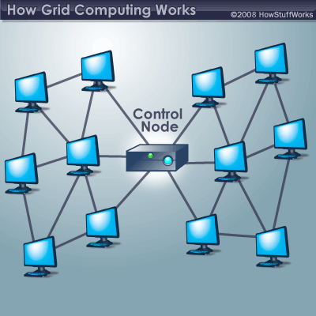
In a basic grid computing system, every computer can access the resources of every other computer belonging to the network.

Slide 18
Grid computing is distinguished from the cluster computing, because in Grid computing each node has heterogeneous and geographical dispersed (such as WAN) and its own resource manager and perform a different task, but in cluster computing resources are managed in a single location. Grid computing is a way of using resources optimally inside an organization.
TYPES OF GRID:- There are many types of grid like:-
COMPUTATIONAL GRID:- It acts as the resource of many computers in a network to a single problem at a time.
DATA GRID:- It deals with the controlled sharing and management of distributed data of large amount.
COLLABORATIVE GRID:- It is the grid which solves collaborative problems.
MANUSCRIPT GRID:- This grid works well when things are presenting in large continuous blocks of text or images.
MODULAR GRID:- This grid works well when columns alone don’t offer enough flexibility for complex problems.

Slide 19
ADVANTAGES OF GRID COMPUTING:- 1) It can solve more complex problems in a very short span of time. 2) It can easily combine with other organization. 3) It can make better use of existing hardware.
Distributed Computing:
Distributed computing is a computing concept that, in its most general sense, refers to multiple computer systems working on a single problem. In distributed computing, a single problem is divided into many parts, and each part is solved by different computers. As long as the computers are networked, they can communicate with each other to solve the problem. If done properly, the computers perform like a single entity.
The ultimate goal of distributed computing is to maximize performance by connecting users and IT resources in a cost-effective, transparent and reliable manner. It also ensures fault tolerance and enables resource accessibility in the event that one of the components fails.

Slide 20
A distributed computing architecture consists of a number of client machines with very lightweight software agents installed with one or more dedicated distributed computing management servers. The agents running on the client machines usually detect when the machine is idle and send a notification to the management server that the machine is not in use and available for a processing job. The agents then requests an application package. When the client machine receives this application package from the management server to process, it runs the application software when it has free CPU cycles and sends the result back to the management server. When the user returns and requires the resources again, the management server returns the resources was using to perform different tasks in the user's absence.

Slide 21
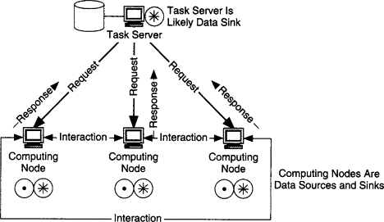

Slide 22
Grid can be thought as a distributed system with non interactive workload that involve a large number of files.
Utility Computing:
Utility computing is the process of providing computing service through an on-demand, pay-per-use billing method. Utility computing is a computing business model in which the provider owns, operates and manages the computing infrastructure and resources, and the subscribers accesses it as and when required on a rental or metered basis.

Slide 23
Utility computing is one of the most popular IT service models, primarily because of the flexibility and economy it provides. This model is based on that used by conventional utilities such as telephone services, electricity and gas. The principle behind utility computing is simple. The consumer has access to a virtually unlimited supply of computing solutions over the Internet or a virtual private network, which can be sourced and used whenever it's required. The back-end infrastructure and computing resources management and delivery is governed by the provider.
Utility computing solutions can include virtual servers, virtual storage, virtual software, backup and most IT solutions.

Slide 24
Pros and Cons of Cloud computing:
Pros:
No cost on infrastructure: Cloud computing is divided into three major categories as per the services: Infrastructure as a Service (IaaS), Platform as a Service (PaaS) and Software as a Service (SaaS).
In all these categories, one thing is common that you don’t need to invest in hardware or any infrastructure. In general, every organization has to spend a lot on their IT infrastructure to set up and hire a specialized team.
Servers, network devices, ISP connections, storage, and software – these are the major things on which you need to invest if we talk about general IT infrastructure.
But if you move to cloud computing services, then you don’t need to invest in these. You simply go to a cloud services provider and buy a cloud service.

Slide 25
Minimum management and cost: By selecting the cloud, you save cost in many ways:
--Zero investment in infrastructure.
--Since you don’t own the infrastructure, you spend nothing on its management or staff to manage it.
--Cloud works on pay as you go model, so you spend only on resources that you need. Nothing more!
When you opt for the cloud, the management of its infrastructure is the sole responsibility of the cloud provider and not of the user.

Slide 26
Forget about administrative or management hassles: Whenever there is a purchase or up-gradation of hardware, a lot of time is wasted looking for best vendors, inviting quotations, negotiating rates, taking approvals, generating POs and waiting for delivery and then in setting up the infrastructure.
This whole process includes lots of administrative/managerial tasks that waste a lot of time.
With cloud services, you just need to compare the best cloud service providers and their plans and buy from the one that matches your requirements. And this whole process doesn’t take much time and saves you a lot of efforts. Your system maintenance tasks are also eliminated in the cloud.

Slide 27
Accessibility and pay per use: Cloud resources are easily accessible from around the globe – anytime, anywhere and from any device and you have complete access to your resources.
This decides your billing also -you only pay for what you use and how much you use. It’s like your phone or electricity bill. But with other IT infrastructure, one spends the complete amount in one go and it is very very rare that those resources are used optimally and thus, the investment goes waste.

Slide 28
Reliability: Your infrastructure in the cloud increases the reliability and availability of applications and services. Cloud services run on pooled and redundant infrastructure which provides you with a higher availability of IT services.
Data control: Another primary advantage of the cloud is that it centralizes all the data from multiple projects and branch offices to a single location. You gain complete control over the data without visiting individual places for checking the information.
Data backup & recovery: Loss of data can significantly impact your business. You might lose critical information which can cost you a huge sum of money, waste your valuable time and adversely impact your brand image.
To prevent it, you can automatically backup all the data to the cloud on a regular basis. This helps you to recover any data in case of accidental deletion, loss because of natural calamity or if the hard drive crashes.

Slide 29
Huge cloud storage: Most cloud services provide you a free, secure and huge storage space to store all your valuable information.
Although most cloud storage services like OneDrive offer you a good amount of free storage, if you use it all, you can always go for buying more secure storage in the cloud.
Automatic software updates: Updating a system every now and then can be a frustrating task for enterprises. The IT department needs to update the system for every individual which not only wastes time but affects productivity.
But if you are using cloud-based applications, they will get automatically updated, without any involvement from the users.

Slide 30
Cons of cloud computing:
Requires good speed internet with good bandwidth: To access your cloud services, you need to have a good internet connection always with good bandwidth to upload or download files to/from the cloud
Downtime: Since the cloud requires high internet speed and good bandwidth, there is always a possibility of service outage, which can result in business downtime. Today, no business can afford revenue or business loss due to downtime or slow down from an interruption in critical business processes.
Limited control of infrastructure: Since you are not the owner of the infrastructure of the cloud, hence you don’t have any control or have limited access to the cloud infra.

Slide 31
Restricted or limited flexibility: The cloud provides a huge list of services, but consuming them comes with a lot of restrictions and limited flexibility for your applications or developments. Also, platform dependency or ‘vendor lock-in’ can sometimes make it difficult for you to migrate from one provider to another.
Ongoing costs: Although you save your cost of spending on whole infrastructure and its management, on the cloud, you need to keep paying for services as long as you use them. But in traditional methods, you only need to invest once.
Security: Security of data is a big concern for everyone. Since the public cloud utilizes the internet, your data may become vulnerable.
In the case of a public cloud, it depends on the cloud provider to take care of your data. So, before opting for cloud services, it is required that you find a provider who follows maximum compliance policies for data security.
For complete security of data on the cloud, one needs to consider a somewhat costlier private cloud option or the hybrid cloud option, where generic data can be on the public cloud and business-critical data is kept on the private cloud.

Slide 32
Vendor Lock-in: Although the cloud service providers assure you that they will allow you to switch or migrate to any other service provider whenever you want, it is a very difficult process.
You will find it complex to migrate all the cloud services from one service provider to another. During migration, you might end up facing compatibility, interoperability and support issues. To avoid these issues, many customers choose not to change the vendor.
Technical issues: Even if you are a tech whiz, the technical issues can occur, and everything can’t be resolved in-house. To avoid interruptions, you will need to contact your service provider for support. However, not every vendor provides 24/7 support to their clients.

Slide 33
A list of advantages and disadvantages of cloud computing:
Advantages of Cloud | Disadvantages of Cloud
No cost of infrastructure | Good internet connection & bandwidth required
Minimum management and cost | Downtime
No administrative or management hassles | Limited control of infrastructure
Easy accessibility | Restricted or limited flexibility
Pay per use | Ongoing costs
Reliability | Security
Data control | Vendor lock-in
Data backup and recovery | Technical Issues
Huge cloud storage | NA

Slide 34
Benefits of cloud computing
Cloud computing offers your business many benefits. It allows you to set up what is essentially a virtual office to give you the flexibility of connecting to your business anywhere, any time. With the growing number of web-enabled devices used in today's business environment (e.g. smartphones, tablets), access to your data is even easier.
There are many benefits to moving your business to the cloud:
Reduced IT costs
Moving to cloud computing may reduce the cost of managing and maintaining your IT systems. Rather than purchasing expensive systems and equipment for your business, you can reduce your costs by using the resources of your cloud computing service provider. You may be able to reduce your operating costs because:
the cost of system upgrades, new hardware and software may be included in your contract
you no longer need to pay wages for expert staff
your energy consumption costs may be reduced
there are fewer time delays.

Slide 35
Scalability
Your business can scale up or scale down your operation and storage needs quickly to suit your situation, allowing flexibility as your needs change. Rather than purchasing and installing expensive upgrades yourself, your cloud computer service provider can handle this for you. Using the cloud frees up your time so you can get on with running your business.
Business continuity
Protecting your data and systems is an important part of business continuity planning. Whether you experience a natural disaster, power failure or other crisis, having your data stored in the cloud ensures it is backed up and protected in a secure and safe location. Being able to access your data again quickly allows you to conduct business as usual, minimizing any downtime and loss of productivity.

Slide 36
Collaboration efficiency
Collaboration in a cloud environment gives your business the ability to communicate and share more easily outside of the traditional methods. If you are working on a project across different locations, you could use cloud computing to give employees, contractors and third parties access to the same files. You could also choose a cloud computing model that makes it easy for you to share your records with your advisers (e.g. a quick and secure way to share accounting records with your accountant or financial adviser).

Slide 37
Flexibility of work practices
Cloud computing allows employees to be more flexible in their work practices. For example, you have the ability to access data from home, on holiday, or via the commute to and from work (providing you have an internet connection). If you need access to your data while you are off-site, you can connect to your virtual office, quickly and easily.
Access to automatic updates
Access to automatic updates for your IT requirements may be included in your service fee. Depending on your cloud computing service provider, your system will regularly be updated with the latest technology. This could include up-to-date versions of software, as well as upgrades to servers and computer processing power.

Slide 38
Evolution of Cloud Computing:
Cloud computing is all about renting computing services. This idea first came in the 1950s. In making cloud computing what it is today, five technologies played a vital role. These are distributed systems and its peripherals, virtualization, web 2.0, service orientation, and utility computing.

Slide 39
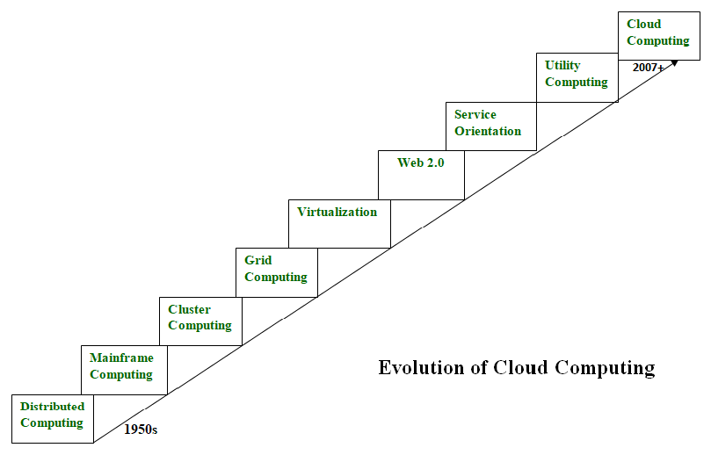

Slide 40
Distributed Systems:
It is a composition of multiple independent systems but all of them are depicted as a single entity to the users. The purpose of distributed systems is to share resources and also use them effectively and efficiently. Distributed systems possess characteristics such as scalability, concurrency, continuous availability, heterogeneity, and independence in failures. But the main problem with this system was that all the systems were required to be present at the same geographical location. Thus to solve this problem, distributed computing led to three more types of computing and they were-Mainframe computing, cluster computing, and grid computing.

Slide 41
Mainframe computing:
Mainframes which first came into existence in 1951 are highly powerful and reliable computing machines. These are responsible for handling large data such as massive input-output operations. Even today these are used for bulk processing tasks such as online transactions etc. These systems have almost no downtime with high fault tolerance. After distributed computing, these increased the processing capabilities of the system. But these were very expensive. To reduce this cost, cluster computing came as an alternative to mainframe technology.
Cluster computing:
In 1980s, cluster computing came as an alternative to mainframe computing. Each machine in the cluster was connected to each other by a network with high bandwidth. These were way cheaper than those mainframe systems. These were equally capable of high computations. Also, new nodes could easily be added to the cluster if it was required. Thus, the problem of the cost was solved to some extent but the problem related to geographical restrictions still pertained. To solve this, the concept of grid computing was introduced.

Slide 42
Grid computing:
In 1990s, the concept of grid computing was introduced. It means that different systems were placed at entirely different geographical locations and these all were connected via the internet. These systems belonged to different organizations and thus the grid consisted of heterogeneous nodes. Although it solved some problems but new problems emerged as the distance between the nodes increased. The main problem which was encountered was the low availability of high bandwidth connectivity and with it other network associated issues. Thus. cloud computing is often referred to as “Successor of grid computing”.

Slide 43
Virtualization:
It was introduced nearly 40 years back. It refers to the process of creating a virtual layer over the hardware which allows the user to run multiple instances simultaneously on the hardware. It is a key technology used in cloud computing. It is the base on which major cloud computing services such as Amazon EC2, VMware vCloud, etc work on. Hardware virtualization is still one of the most common types of virtualization.
Web 2.0:
It is the interface through which the cloud computing services interact with the clients. It is because of Web 2.0 that we have interactive and dynamic web pages. It also increases flexibility among web pages. Popular examples of web 2.0 include Google Maps, Facebook, Twitter, etc. Needless to say, social media is possible because of this technology only. In gained major popularity in 2004.

Slide 44
Service orientation:
It acts as a reference model for cloud computing. It supports low-cost, flexible, and evolvable applications. Two important concepts were introduced in this computing model. These were Quality of Service (QoS) which also includes the SLA (Service Level Agreement) and Software as a Service (SaaS).
Utility computing:
It is a computing model that defines service provisioning techniques for services such as compute services along with other major services such as storage, infrastructure, etc which are provisioned on a pay-per-use basis.
Thus, the above technologies contributed to the making of cloud computing.

Slide 45
Business drivers for adopting cloud computing:
Business Hike:
Analyzing your moves gives fabricated results. Thus, if you view a certain range of hike in your business, it might be one of the cloud drivers. The growth in business is one of the major obligations, that any organization could ever rate.
Therefore, based on the steps of the plan for driving the cloud services, it is prominent to boil out the business strategy by the consideration of cloud adoption.
- Balanced Cost Structure:
This is one of the most recognized factors, acting as a driver for cloud adoption. The number of organizations has witnessed that employing the cloud bolsters in cutting the cost, resulting in turning down of license for legacy systems.
Depending on the cloud for acquiring cloud storage services, reduction in office space and attaining the quality, domes as the driver for cloud adoption.

Slide 46
Improvised Productivity:
When the organizations are adopting the means of fabricated technology, it is believed to view tremendous change in the range of productivity.
Productivity is the factor, often considered as a driver of cloud adoption. If the cloud is structured at a significant rate, it could produce imitable results, in favour of an organization.
- Efficiency:
Improved Efficiency, with minimal errors, is one of the key drivers, propagating the reasons for adoption of the cloud.
When the organization adopts any newer means of technology, it always has an underlying motive to access the medium for fulfilling the business requirement, with a hike in business and optimized cloud solutions. At its core, efficiency is about removing unnecessary steps to streamline processes in order to increase productivity or deliver on customer requirements faster

Slide 47
Scalability:
The scalable service of the cloud is one the biggest key driver, acting in the favor of organizations. The cloud-enabled services are swaddled in such a manner that one can scale the range of services as per its requirement.
One can add on more number of services with customized features if the organization feels ready to step up. Also, the organization can step down in terms of services, if it finds it as the far-reaching target.

Slide 48
NIST Model:
NIST is part of the U.S. Department of Commerce and works to promote the economy and public welfare by providing technical leadership for measurement and standards infrastructure.
From the NIST definition of cloud computing, “Cloud computing is a model for enabling ubiquitous, convenient, on-demand network access to a shared pool of configurable computing resources that can be rapidly provisioned and released with minimal management effort or service provider interactive.” NIST provides the following definitions of the essential characteristics and service and deployment models for cloud computing.

Slide 49
Essential Cloud Computing Characteristics:
On-demand self-service: consumers can unilaterally provision computing capabilities as needed automatically without requiring human interaction with each service provider.
Broad network access: capabilities are available over the network and accessed through standard mechanism that promote use by heterogeneous thin or thick client platforms.
Resources pooling: The provider’s computing resources are pooled to serve multiple consumers using a multi-tenant model, with different physical and virtual resources dynamically assigned and reassigned according to consumer demand
Rapid elasticity: capabilities can be elastically provisioned and released to scale rapidly outward and inward commensurate with demand.
Measured service: cloud systems automatically control and optimize resource use by leveraging a metering capability at some level of abstraction appropriate to the type of service.

Slide 50
Service Models: The many paradigms of cloud computing can be broken down into three unique service model classifications: Software as a Service (SaaS), Platform as a Service (PaaS), and Infrastructure as a Service (IaaS).
Software as a Service (Saas)
Platform as a Service (PaaS)
Infrastructure as a Service (IaaS)
Deployment Models:
Private cloud
Community cloud
Public cloud
Hybrid cloud

Slide 51
Infrastructure as a Service | IaaS
Iaas is also known as Hardware as a Service (HaaS). It is one of the layers of the cloud computing platform. It allows customers to outsource their IT infrastructures such as servers, networking, processing, storage, virtual machines, and other resources. Customers access these resources on the Internet using a pay-as-per use model.
In traditional hosting services, IT infrastructure was rented out for a specific period of time, with pre-determined hardware configuration. The client paid for the configuration and time, regardless of the actual use. With the help of the IaaS cloud computing platform layer, clients can dynamically scale the configuration to meet changing requirements and are billed only for the services actually used.
A cloud computing service provider, such as Azure, manages the infrastructure, while you purchase, install, configure and manage your own software—operating systems, middleware and applications.

Slide 52
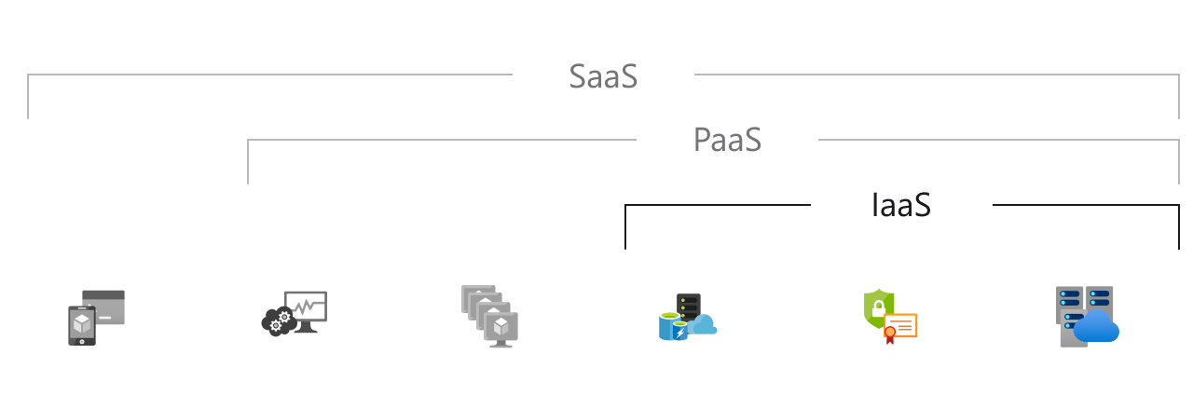
Hosted applications/apps | Development tools, database management, business analytics | Operating systems | Servers and storage | Networking firewalls/security | Data center physical plant/building

Slide 53
IaaS provider provides the following services -
Compute: Computing as a Service includes virtual central processing units and virtual main memory for the Vms that is provisioned to the end- users.
Storage: IaaS provider provides back-end storage for storing files.
Network: Network as a Service (NaaS) provides networking components such as routers, switches, and bridges for the Vms.
Load balancers: It provides load balancing capability at the infrastructure layer.

Slide 54
Advantages of IaaS cloud computing layer
There are the following advantages of IaaS computing layer -
1. Shared infrastructure
IaaS allows multiple users to share the same physical infrastructure.
2. Web access to the resources
Iaas allows IT users to access resources over the internet.
3. Pay-as-per-use model
IaaS providers provide services based on the pay-as-per-use basis. The users are required to pay for what they have used.
4. Focus on the core business
IaaS providers focus on the organization's core business rather than on IT infrastructure.
5. On-demand scalability
On-demand scalability is one of the biggest advantages of IaaS. Using IaaS, users do not worry about to upgrade software and troubleshoot the issues related to hardware components.

Slide 55
Disadvantages of Iaas:
1. Security
Security is one of the biggest issues in IaaS. Most of the IaaS providers are not able to provide 100% security.
2. Maintenance & Upgrade
Although IaaS service providers maintain the software, but they do not upgrade the software for some organizations.
3. Interoperability issues
It is difficult to migrate VM from one IaaS provider to the other, so the customers might face problem related to vendor lock-in.

Slide 56
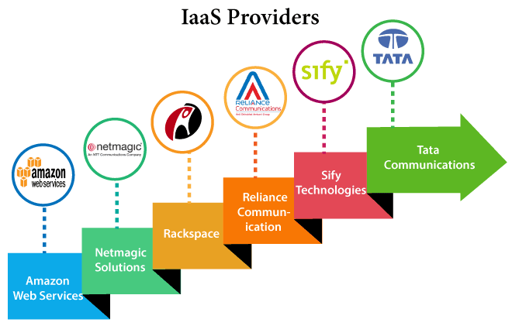
Top Iaas Providers who are providing IaaS cloud computing platform

Slide 57
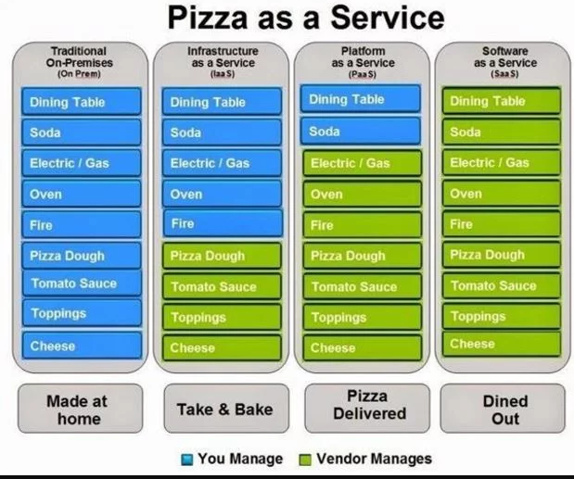

Slide 58
IaaS (Infra as a Service)
IaaS provides the infrastructure such as virtual machines and other resources like virtual-machine disk image library, block and file-based storage, firewalls, load balancers, IP addresses, virtual local area networks etc. Infrastructure as service or IaaS is the basic layer in cloud computing model.
Common examples: DigitalOcean, Linode, Rackspace, Amazon Web Services (AWS), Cisco Metapod, Microsoft Azure, Google Compute Engine (GCE) are some popular examples of Iaas.
PaaS (Platform as a Service)
PaaS or platform as a service model provides you computing platforms which typically includes an operating system, programming language execution environment, database, web server. technically It is a layer on top of IaaS as the second thing you demand after Infrastructure is a platform.
Common examples: AWS Elastic Beanstalk, Windows Azure, Heroku, Force.com, Google App Engine, Apache Stratos.

Slide 59
SaaS (Software as a Service)
In a SaaS, you are provided access to application services installed at a server. You don’t have to worry about installation, maintenance or coding of that software. You can access and operate the software with just your browser. You don’t have to download or install any kind of setup or OS, the software is just available for you to access and operate. The software maintenance or setup or help will be provided by SaaS provider company and you will only have to pay for your usage.
Common examples: Google Apps, Microsoft office365, Google docs, Gmail, WHMCS billing software

Slide 60
Platform as a Service | PaaS
Platform as a Service (PaaS) provides a runtime environment. It allows programmers to easily create, test, run, and deploy web applications. You can purchase these applications from a cloud service provider on a pay-as-per use basis and access them using the Internet connection. In PaaS, back end scalability is managed by the cloud service provider, so end- users do not need to worry about managing the infrastructure.
PaaS includes infrastructure (servers, storage, and networking) and platform (middleware, development tools, database management systems, business intelligence, and more) to support the web application life cycle.
Example: Google App Engine, Force.com, Joyent, Azure.

Slide 61
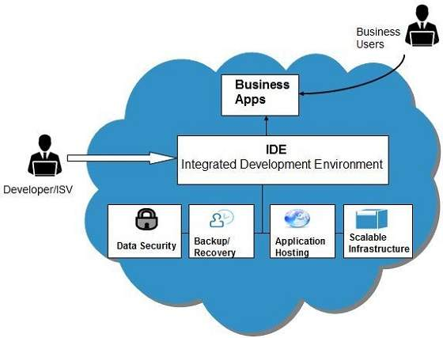
The following diagram shows how PaaS offers an API and development tools to the developers and how it helps the end user to access business applications.

Slide 62
PaaS providers provide the Programming languages, Application frameworks, Databases, and Other tools:
Programming languages
PaaS providers provide various programming languages for the developers to develop the applications. Some popular programming languages provided by PaaS providers are Java, PHP, Ruby, Perl, and Go.
2. Application frameworks
PaaS providers provide application frameworks to easily understand the application development. Some popular application frameworks provided by PaaS providers are Node.js, Drupal, Joomla, WordPress, Spring, Play, Rack, and Zend.
3. Databases
PaaS providers provide various databases such as ClearDB, PostgreSQL, MongoDB, and Redis to communicate with the applications.
4. Other tools
PaaS providers provide various other tools that are required to develop, test, and deploy the applications.

Slide 63
Advantages of PaaS
There are the following advantages of PaaS -
1) Simplified Development
PaaS allows developers to focus on development and innovation without worrying about infrastructure management.
2) Lower risk
No need for up-front investment in hardware and software. Developers only need a PC and an internet connection to start building applications.
3) Prebuilt business functionality
Some PaaS vendors also provide already defined business functionality so that users can avoid building everything from very scratch and hence can directly start the projects only.
4) Instant community
PaaS vendors frequently provide online communities where the developer can get the ideas to share experiences and seek advice from others.
5) Scalability
Applications deployed can scale from one to thousands of users without any changes to the applications.

Slide 64
Disadvantages of PaaS:
Vendor lock-in
One has to write the applications according to the platform provided by the PaaS vendor, so the migration of an application to another PaaS vendor would be a problem.
For example, an application written in Python against API of Google, and using App Engine of Google is likely to work only in that environment.
2) Data Privacy
Corporate data, whether it can be critical or not, will be private, so if it is not located within the walls of the company, there can be a risk in terms of privacy of data.
3) Integration with the rest of the systems applications
It may happen that some applications are local, and some are in the cloud. So there will be chances of increased complexity when we want to use data which in the cloud with the local data.

Slide 65
What is Software-as-a-Service (SaaS)?
Software-as-a-Service, or SaaS for short, is a cloud-based method of providing software to users. SaaS users subscribe to an application rather than purchasing it once and installing it. Users can log into and use a SaaS application from any compatible device over the Internet. The actual application runs in cloud servers that may be far removed from a user's location.

Slide 66
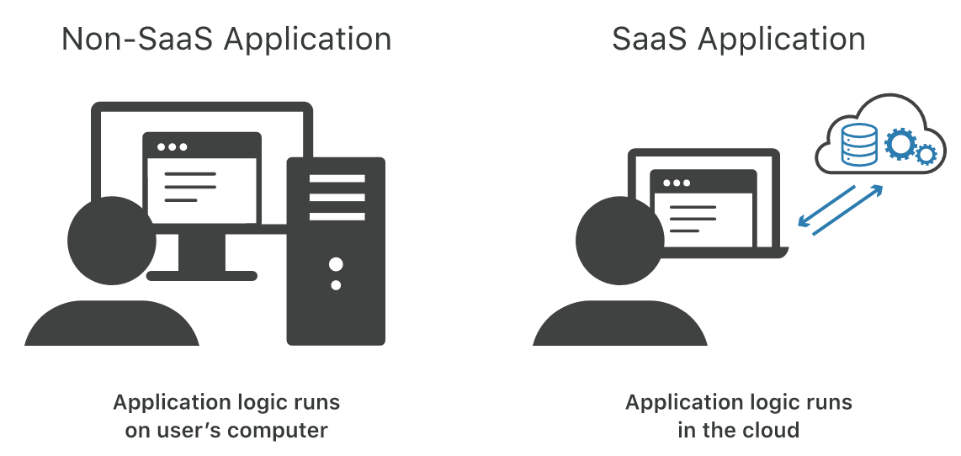

Slide 67
A SaaS application may be accessed through a browser or through an app. Online email applications that users access through a browser, such as Gmail and Office 365, are common examples of SaaS applications.
The difference between SaaS and a software installation on a user's computer is somewhat like the difference between streaming a TV show online and buying all the seasons of the TV show on DVD.
Someone who buys a TV show on DVD only needs to pay for it once; however, they will need to store and maintain the DVDs, and if they change their hardware – for instance, if they replace their DVD player with a Blu-ray player – then they will need to purchase the physical media again. Streaming the show instead means a third party handles all the storage and upgrades, and all a user needs to do is press play. However, streaming is dependent on an Internet connection, and users typically need to pay a recurring monthly fee to maintain their access.

Slide 68
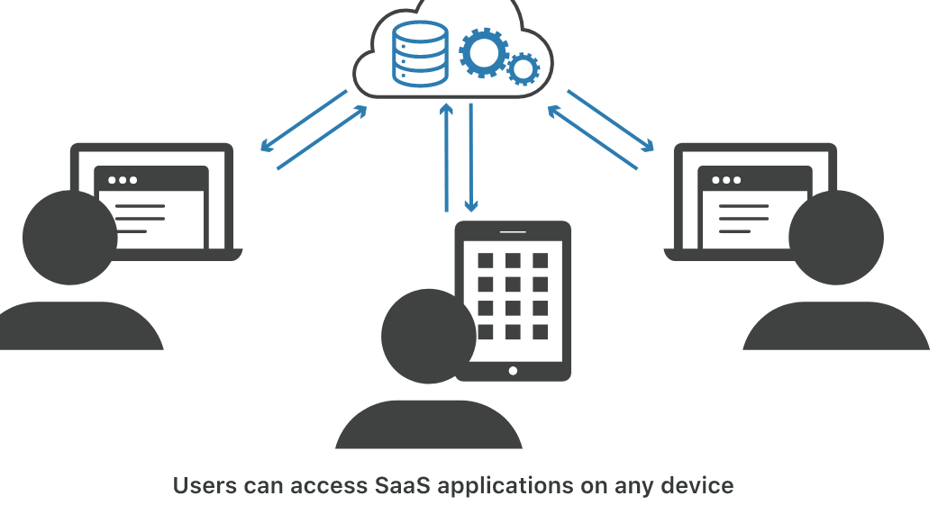

Slide 69
What does 'as a service' mean?
Consider the difference between valet parking and renting a parking spot. Valet parking is a service, while a parking spot is a product, even though both provide the same benefit to the customer: a place to leave their car.
Traditionally, software vendors sold their software to users as a product. However, in the SaaS model they actively provide and maintain the software for their users, via the cloud. They host and maintain the databases and code necessary for the application to run, and they run the application on their servers. Thus, SaaS is more like a service than a product.

Slide 70
What is the cloud?
"The cloud" refers to remote web servers in various data centers that host databases and run application code. Cloud providers deliver their services to customers or end users via the Internet.
What are the advantages and disadvantages of using SaaS?
The SaaS model has a number of pros and cons, although for modern businesses and users the pros of SaaS often outweigh the cons. Here are some of the advantages and disadvantages of using SaaS applications:
Advantage:
Access from anywhere, on any device. Typically, users can log into SaaS applications from any device and any location. This offers a great deal of flexibility – businesses can allow employees to operate all over the world, and users can access their files no matter they are. In addition, most users use multiple devices and replace them often; users don't need to reinstall SaaS applications or purchase new licenses each time they switch to a new device.
No need for updates or installations. The SaaS provider updates and patches the application on an ongoing basis.
Scalability. The SaaS provider handles scaling up the application, such as adding more database space or more compute power as usage increases.
Cost savings. SaaS cuts down on internal IT costs and overhead. The SaaS provider maintains the servers and infrastructure that support the application, and the only cost to a business is the subscription cost of the application.

Slide 71
Disadvantage:
The need for stronger access control. The increased accessibility of SaaS applications also means that verifying user identity and controlling access levels becomes very important. With SaaS, organizational assets are no longer kept within an internal network, separate from the outside world. Instead, user access is based on user identity: if someone has the right login credentials, they are granted access. Strong identity verification thus becomes crucial.
Vendor lock-in. A business may become overly reliant on the SaaS application provider. It's time-consuming and expensive to move to a new application if an organization's entire database is stored within the old application.
Disadvantage (for enterprises): Security and compliance. With SaaS applications, the responsibility for protecting those applications and their data moves from internal IT teams to the external SaaS providers. For small to medium-sized businesses, this is less of a disadvantage, as large cloud providers typically have more resources for putting strong security in place. But this can be a challenge if a large business faces tight security or regulatory standards. In some cases businesses will be unable to assess their applications' security themselves, for instance by performing penetration testing. Essentially, they have to take the external SaaS provider's word that the application is secure.

Slide 72
Cloud Computing Stack:
Cloud computing is a broad term that describes a wide range of services. We can categorise cloud services into one of three offerings: software-as-a-service (SaaS), platform-as-a-service (PaaS) and infrastructure-as-a-service (IaaS). They are called ‘as a service’ because businesses purchase them as service products from third parties. Together, they are the cloud computing stack.
SaaS are used by end users such as employees in a business, programmers use PaaS for developing applications, and IaaS are used by network architects to design a firm’s IT systems

Slide 73
Cloud computing has commonly been referred to as a “stack” because it typically encompasses many different types of services which have been built on top of each other under a “cloud”. Cloud computing has been defined by the NIST (National Institute of Standards and Technology) as a model that enables on-demand access to a shared resource pool consisting of servers, networks, applications, services and storage which can be rapidly deployed with minimal management efforts. There are three different types of cloud computing services namely Platform as a Service or PaaS, Software as a Service or SaaS and Infrastructure as a Service or IaaS.

Slide 74
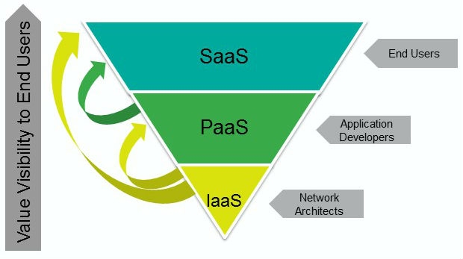

Slide 75
HOW DOES CLOUD COMPUTING WORK?
Cloud computing is an application-based software infrastructure that stores data on remote serves, which can be accessed through the internet. To understand how cloud computing works, it can be divided into front-end and backend.
The front end enables a user to access data stored in the cloud using an internet browser or a cloud computing software. However, the primary component of cloud computing – responsible for securely storing data and information – is the backend. It comprises servers, computers, databases, and central servers.
The central server facilitates operations by following a set of rules known as protocols. It uses a software, middleware, to ensure seamless connectivity between devices/computers linked via cloud computing. Cloud computing service providers usually maintain multiple copies of the data to mitigate instances of security threats, data loss, data breach, etc.

Slide 76
Let's say you're an executive at a large corporation. Your particular responsibilities include making sure that all of your employees have the right hardware and software they need to do their jobs. Buying computers for everyone isn't enough -- you also have to purchase software or software licenses to give employees the tools they require. Whenever you have a new hire, you have to buy more software or make sure your current software license allows another user. It's so stressful that you find it difficult to go to sleep on your huge pile of money every night.
Soon, there may be an alternative for executives like you. Instead of installing a suite of software for each computer, you'd only have to load one application. That application would allow workers to log into a Web-based service which hosts all the programs the user would need for his or her job. Remote machines owned by another company would run everything from e-mail to word processing to complex data analysis programs. It's called cloud computing, and it could change the entire computer industry.

Slide 77
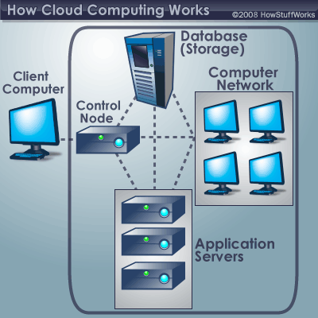

Slide 78
In a cloud computing system, there's a significant workload shift. Local computers no longer have to do all the heavy lifting when it comes to running applications. The network of computers that make up the cloud handles them instead. Hardware and software demands on the user's side decrease. The only thing the user's computer needs to be able to run is the cloud computing system's interface software, which can be as simple as a Web browser, and the cloud's network takes care of the rest.
There's a good chance you've already used some form of cloud computing. If you have an e-mail account with a Web-based e-mail service like Hotmail, Yahoo! Mail or Gmail, then you've had some experience with cloud computing. Instead of running an e-mail program on your computer, you log in to a Web e-mail account remotely. The software and storage for your account doesn't exist on your computer -- it's on the service's computer cloud.

Slide 79
Role of network in cloud computing:
Emerging capabilities of network have enabled cloud to successfully provide on-demand services which can unilaterally provision computing capabilities such as servers, network, OS and storage. Further, it allows resource pooling where multiple users through multiple tenant model (multiple customer utilizing the same facility) can access different physical and virtual resources. Additionally, virtualization permits applications, compute and network resources to reside anywhere, which are then accessed through the network, thus allowing these resources to be flexible and scalable. Cloud computing also has the capability to measure the services being offered through the usage of charge back or metering where it can control and optimize resource usage. The network plays a key role in the delivery of cloud-based services as it provides a means to connect every IT system and has the ability to provision and scale these resources to meet application and end-user requirements.

Slide 80
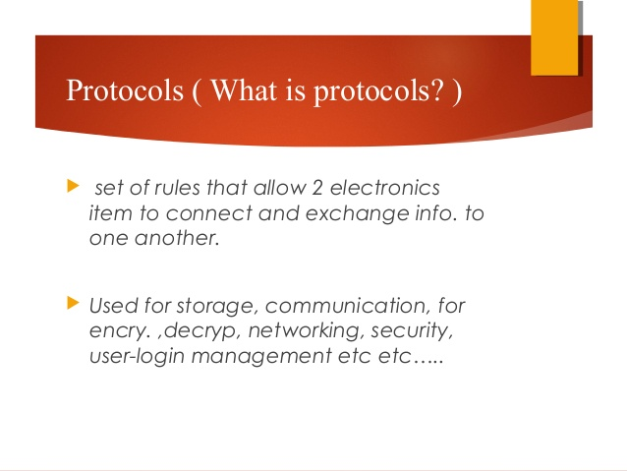

Slide 81
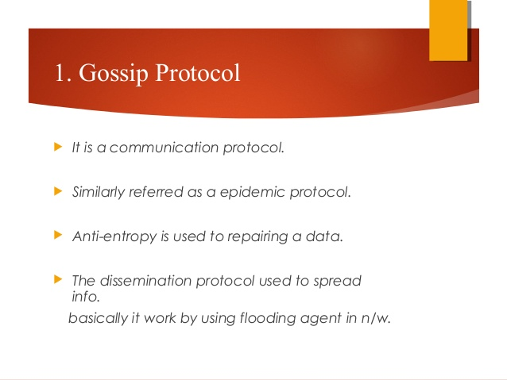

Slide 82
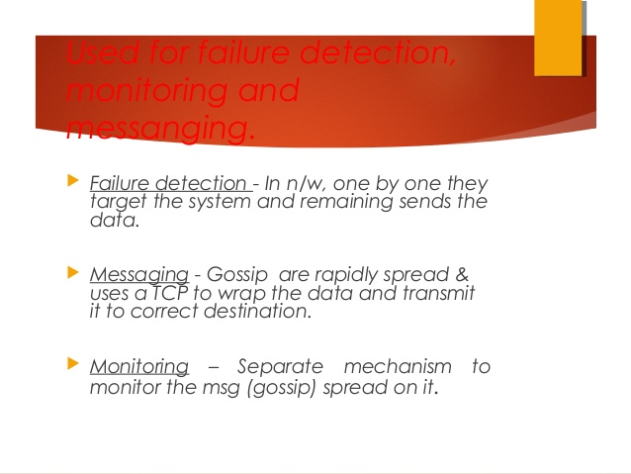

Slide 83
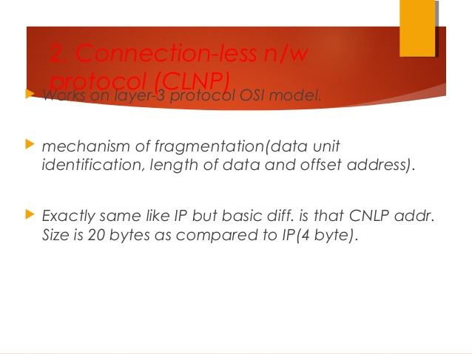

Slide 84
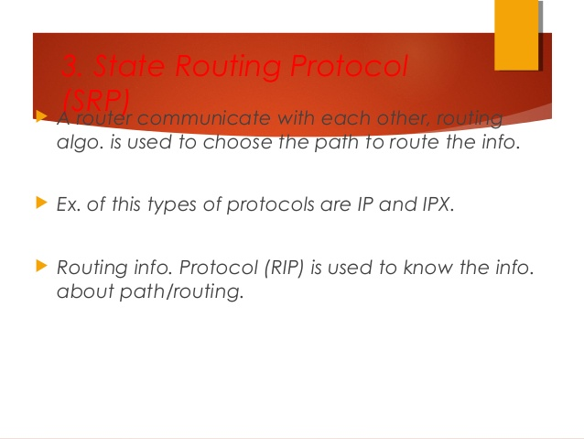

Slide 85
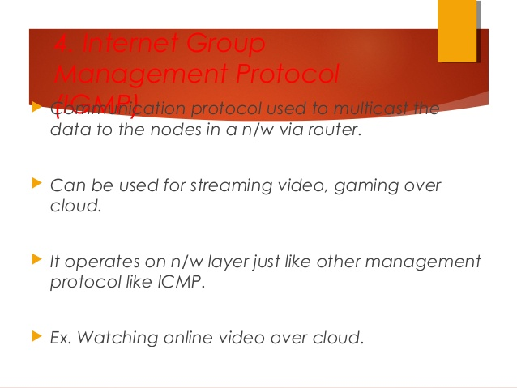

Slide 86
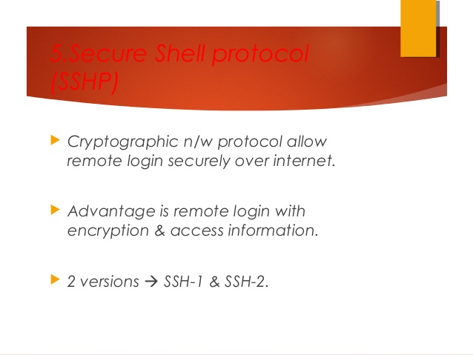

Slide 87
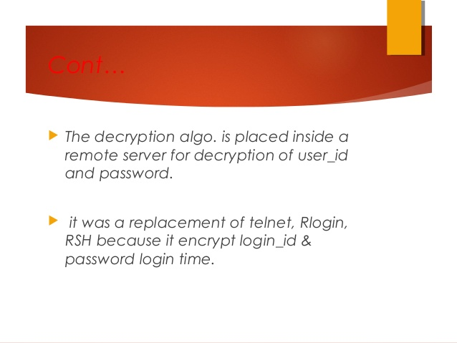

Slide 88
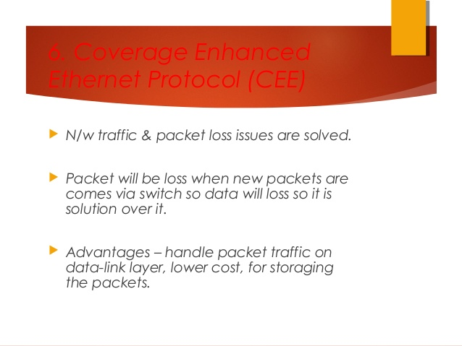

Slide 89
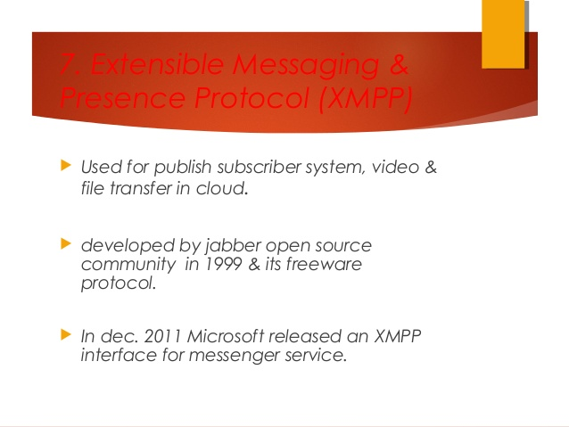

Slide 90
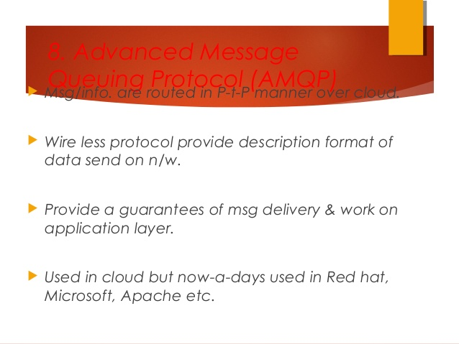

Slide 91
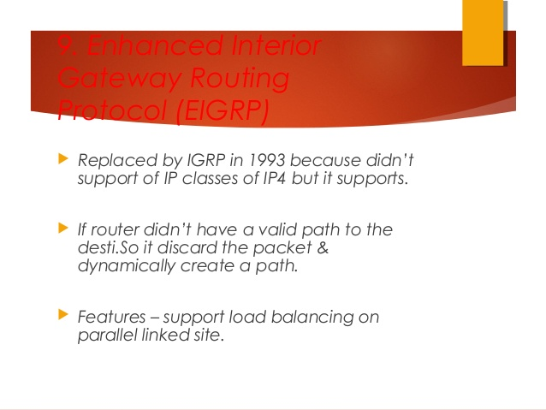

Slide 92
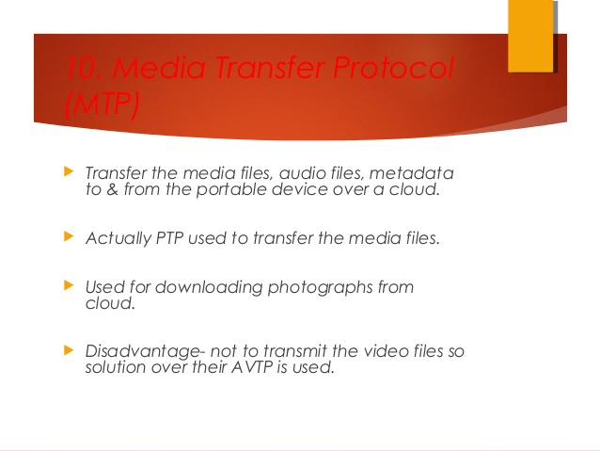

Slide 93
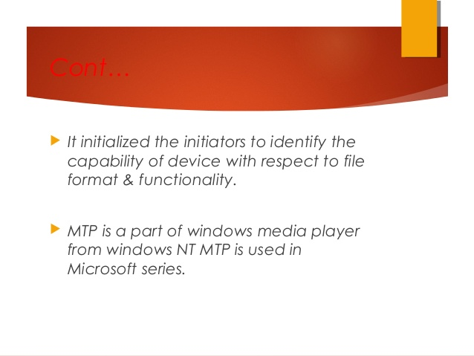

Slide 94
XaaS:
XaaS is a general, collective term that refers to the delivery of Anything as a service or Everything-as-a-Service (XaaS). It recognizes the vast number of products, tools and technologies that vendors now deliver to users as a service over a network -- typically the internet -- rather than provide locally or on-site within an enterprise.
There are countless examples of XaaS, but the most common encompass the three general cloud computing models: Software as a Service (SaaS), Platform as a Service (PaaS) and Infrastructure as a Service (IaaS).

Slide 95
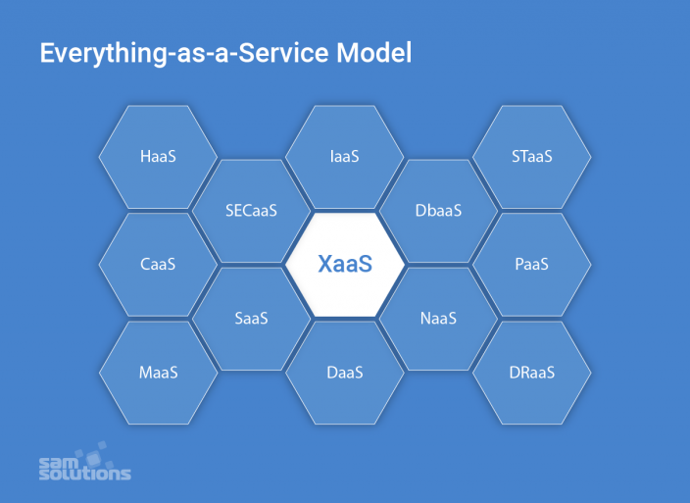

Slide 96
Hardware-as-a-Service (HaaS)
Managed service providers (MSP) own some hardware and install it on customers’ sites on demand. Customers utilize the hardware in accordance with service level agreements. This pay-as-you-go model is similar to leasing and can be compared to IaaS when computing resources are located at MSP’s site and provided to users as virtual equivalents of physical hardware.
The Haas model is especially cost-effective for small or mid-sized businesses.

Slide 97
Communication-as-a-Service (CaaS)
This model includes different communication solutions such as VoIP (voice over IP or Internet telephony), IM (instant messaging), video conference applications that are hosted in the vendor’s cloud. A company can selectively deploy communication apps that best suit their current needs for a certain period and pay for this usage period only.
Such an approach is cost-effective and reduces expenses for short-time communication needs.
Desktop-as-a-Service (DaaS)
Desktops are delivered as virtual services along with the apps needed for use. Thus, a client can work on a personal computer, using the computing capacities of third-party servers (which can be much more powerful than those of a PC).
A DaaS provider is typically responsible for storing, securing and backing up user data, as well as delivering upgrades for all the supported desktop apps.

Slide 98
Security-as-a-Service (SECaaS)
This is the model of outsourced security management. A provider integrates their security services into your company’s infrastructure and, as a rule, delivers them over the Internet. Such services may include anti-virus software, encryption, authentication, intrusion detection solutions and more.
Healthcare-as-a-Service (HaaS)
With electronic medical records (EMR) and hospital information systems (HIS), the healthcare industry is transforming into Healthcare-as-a-Service. Medical treatment is becoming more data-driven and patient-centric. Thanks to the IoT, wearables and other emerging technologies, the following services are available:
Online consultations with doctors
Health monitoring 24/7
Medicine delivery at your doorstep
Lab samples collection even at home and delivery of results as soon as they are ready
Access to your medical records 24/7
HaaS creates opportunities for almost all categories of citizens to get qualified medical help.

Slide 99
Transportation-as-a-Service (TaaS)
Important trends of modern society are mobility and freedom of transportation at different distances. There are numerous apps popping up connected with transport, so a part of this industry is transforming into an -aaS model. The most vivid examples are:
Carsharing (you can rent a car at any place via a special app and drive anywhere you need, paying for the time you use a car, or for the distance you cover)
Uber taxi services (you order a taxi via an app, which calculates the cost of the rout in advance). Uber is planning to test flying taxis and self-driving planes in the near future.
TaaS model is not only convenient but also ecologically friendly.

Slide 100
Database as a Service (DBaaS): provides access to a database platform through the cloud. Public cloud providers like AWS and Azure have DBaaS offerings.
Malware as a Service (MaaS): uses the public cloud to help organizations guard against common attacks, such as ransomware and distributed denial of service (DDoS). VMware AppDefense is one emerging example of MaaS.

Slide 101
Benefits of XaaS:
The market of services provided via cloud computing and the Internet is expanding at a rapid pace due to a range of advantages they provide both for organizations and end-users. The biggest benefits are:
Scalability (outsourcing provides access to unlimited computing capacities, storage space, RAM, etc; a company can quickly and seamlessly scale its processes up and down depending on requirements and doesn’t have to worry about additional deployments or downtimes)
Cost- and time-effectiveness (a company doesn’t purchase its personal equipment and doesn’t need to deploy it, saving much time and money; a pay-as-you-go model is also beneficial)
Focus on core competencies (there’s no need to set up apps and programs or conduct training for employees; consequently, they can concentrate on their direct duties and achieve better performance)
The high quality of services (since professionals support and maintain your infrastructure and systems, they provide the latest updates and all the emerging technologies, guaranteeing the quality of services)
Better customer experience (the above-mentioned pros lead to customer satisfaction and increase customer loyalty)
However, -aaS services are not without flaws. The biggest drawbacks are mostly related to end users and concern the security of personal data and risks of massive data loss.
Many consumers are afraid to fully depend on cloud providers and lose control over their business. Service providers, on their part, are doing their best to address such concerns and allow organizations to migrate more workloads into the cloud.

Slide 102
Deployment Models
Deployment models define the type of access to the cloud, i.e., how the cloud is located? Or
A cloud deployment model is a specific configuration of environment parameters such as the accessibility and proprietorship of the deployment infrastructure and storage size. This means that deployment types vary depending on who controls the infrastructure and where it’s located.
Cloud can have any of the four types of access: Public, Private, Hybrid, and Community.

Slide 103
Public Cloud
This type of cloud services is provided on a network for public use. Customers have no control over the location of the infrastructure. It is based on a shared cost model for all the users, or in the form of a licensing policy such as pay per user. Public deployment models in the cloud are perfect for organizations with growing and fluctuating demands. It is also popular among businesses of all sizes for their web applications, webmail, and storage of non-sensitive data.
The public cloud deployment model is the first choice for businesses with low privacy concerns. When it comes to popular public cloud deployment models, examples are Amazon Elastic Compute Cloud (Amazon EC2 — the top service provider according to ZDNet), Microsoft Azure, Google App Engine, IBM Cloud, Salesforce Heroku and others.

Slide 104
The Advantages of a Public Cloud
Hassle-free infrastructure management. Having a third party running your cloud infrastructure is convenient: you do not need to develop and maintain your software because the service provider does it for you. In addition, the infrastructure setup and use are uncomplicated.
High scalability. You can easily extend the cloud’s capacity as your company requirements increase.
Reduced costs. You pay only for the service you use, so there’s no need to invest in hardware or software.
24/7 uptime. The extensive network of your provider’s servers ensures your infrastructure is constantly available and has improved operation time.

Slide 105
The Disadvantages of a Public Cloud
Compromised reliability. That same server network is also meant to ensure against failure But often enough, public clouds experience outages and malfunction, as in the case of the 2016 Salesforce CRM disruption that caused a storage collapse.
Data security and privacy issues give rise to concern. Although access to data is easy, a public deployment model deprives users of knowing where their information is kept and who has access to it.
The lack of a bespoke service. Service providers have only standardized service options, which is why they often fail to satisfy more complex requirements.

Slide 106
Private Cloud
There is little to no difference between a public and a private model from the technical point of view, as their architectures are very similar. However, as opposed to a public cloud that is available to the general public, only one specific company owns a private cloud. That is why it is also called an internal or corporate model.
The server can be hosted externally or on the premises of the owner company. Regardless of their physical location, these infrastructures are maintained on a designated private network and use software and hardware that are intended for use only by the owner company.
A clearly defined scope of people have access to the information kept in a private repository, which prevents the general public from using it. In light of numerous breaches in recent years, a growing number of large corporations has decided on a closed private cloud model, as this minimizes data security issues.

Slide 107
Compared to the public model, the private cloud provides wider opportunities for customizing the infrastructure to the company’s requirements. A private model is especially suitable for companies that seek to safeguard their mission-critical operations or for businesses with constantly changing requirements.
Multiple public cloud service providers, including Amazon, IBM, Cisco, Dell and Red Hat, also provide private solutions.

Slide 108
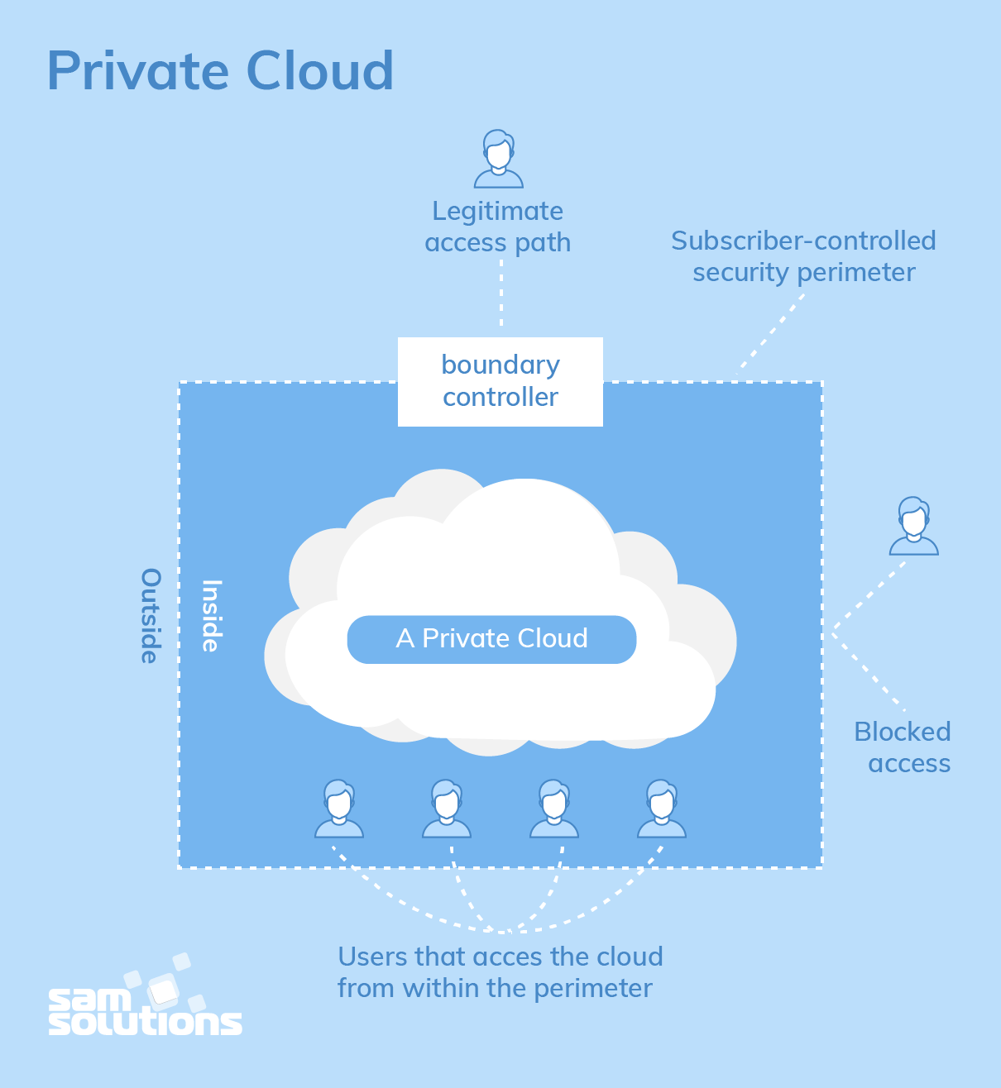

Slide 109
The Benefits of a Private Cloud:
All the benefits of this deployment model result from its autonomy. They are the following:
Bespoke and flexible development and high scalability, which allows companies to customize their infrastructures in accordance with their requirements
High security, privacy and reliability, as only authorized persons can access resources
The Drawbacks of a Private Cloud:
The major disadvantage of the private cloud deployment model is its cost, as it requires considerable expense on hardware, software and staff training. That is why this secure and flexible computing deployment model is not the right choice for small companies.

Slide 110
Community Cloud
A community deployment model largely resembles the private one; the only difference is the set of users. Whereas only one company owns the private cloud server, several organizations with similar backgrounds share the infrastructure and related resources of a community cloud.
If all the participating organizations have uniform security, privacy and performance requirements, this multi-tenant data center architecture helps these companies enhance their efficiency, as in the case of joint projects. A centralized cloud facilitates project development, management and implementation. The costs are shared by all users. Or
It is a mutually shared model between organizations that belong to a particular community such as banks, government organizations, or commercial enterprises. Community members generally share similar issues of privacy, performance, and security. This type of deployment model of cloud computing is managed and hosted internally or by a third-party vendor.

Slide 111
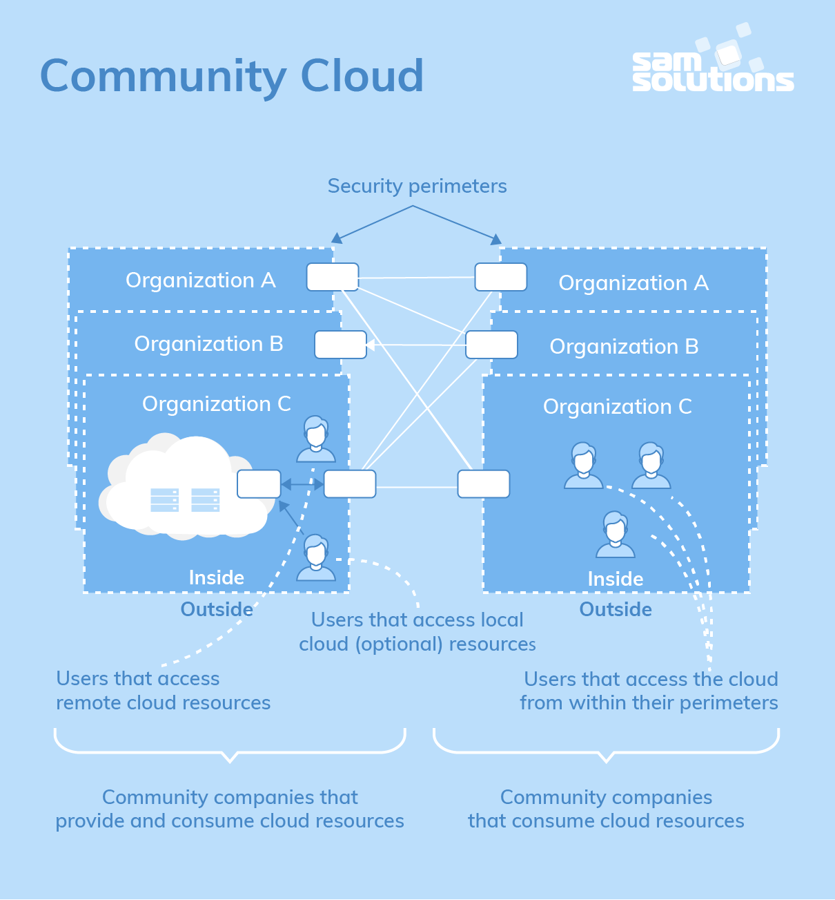

Slide 112
The Strengths of a Community Cloud:
Cost reduction
Improved security, privacy and reliability
Ease of data sharing and collaboration
The Shortcomings of a Community Cloud:
High cost compared to the public deployment model
Sharing of fixed storage and bandwidth capacity
Hybrid Cloud:
As is usually the case with any hybrid phenomenon, a hybrid cloud encompasses the best features of the abovementioned deployment models (public, private and community). It allows companies to mix and match the facets of the three types that best suit their requirements.
As an example, a company can balance its load by locating mission-critical workloads on a secure private cloud and deploying less sensitive ones to a public one. The hybrid cloud deployment model not only safeguards and controls strategically important assets but does so in a cost- and resource-effective way. In addition, this approach facilitates data and application portability.

Slide 113
The Benefits of a Hybrid Cloud:
Improved security and privacy
Enhanced scalability and flexibility
Reasonable price

Slide 114
 | Public | Private | Community | Hybrid
Ease of setup and use | Easy | Requires IT proficiency | Requires IT proficiency | Requires IT proficiency
Data security and privacy | Low | High | Comparatively high | High
Data control | Little to none | High | Comparatively high | Comparatively high
Reliability | Low | High | Comparatively high | High
Scalability and flexibility | High | High | Fixed capacity | High
Cost-effectiveness | The cheapest | Cost-intensive; the most expensive model | Cost is shared among community members | Cheaper than a private model but more costly than a public one
Demand for in-house hardware | No | Depends | Depends | Depends

